Slide 1
Java Programming
Introduction to Java Programming

Slide 2
Course Content
Introduction to Java
Java Basics
Expressions
Control Flow
Methods
Arrays
Arraylists
Classes
Inheritance
Polymorphism
Binding
Abstract Classes
Graphical User Interface

Slide 3
References
The textbook is Deitel & Deitel, Java How to Program (late objects), 10th Edition, Prentice Hall (2014).
Web Resources

Slide 4
Today’s Agenda
Topics:
Object-oriented Programming Concepts
How does Java compare with Python?
Anatomy of Java
Setting Up and Getting Started in Java Programming
Notepad++, TextPad, Eclipse
Reading:
The Java Tutorials
Lesson: Object-Oriented Programming Concepts
https://docs.oracle.com/javase/tutorial/java/concepts/index.html
Welcome to Java for Python Programmers
http://interactivepython.org/courselib/static/java4python/index.html

Slide 5
1. Object-oriented Programming Concepts
Focuses on how these concepts relate to the real world, while simultaneously providing an introduction to the syntax of the Java programming language
Concepts:
Objects,
Classes,
Inheritance, and
Interfaces

Slide 6
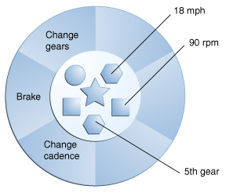
1. OO Programming Concepts Objects and Classes
What Is an Object?
An object is a software bundle of related state and behavior.
Software objects are often used to model the real-world objects that you find in everyday life.
explains how state and behavior are represented within an object,
introduces the concept of data encapsulation, and
explains the benefits of designing your software in this manner.
What Is a Class?
A class is a blueprint or prototype from which objects are created.
defines a class that models the state and behavior of a real-world object.
It intentionally focuses on the basics, showing how even a simple class can cleanly model state and behavior.

Slide 7
1. OO Programming Concepts Inheritance & Interface
What Is Inheritance?
Inheritance provides a powerful and natural mechanism for organizing and structuring your software.
explains how classes inherit state and behavior from their superclasses, and
explains how to derive one class from another using the simple syntax provided by the Java programming language.
What Is an Interface?
An interface is a contract between a class and the outside world.
When a class implements an interface, it promises to provide the behavior published by that interface.
defines a simple interface and explains the necessary changes for any class that implements it.

Slide 8
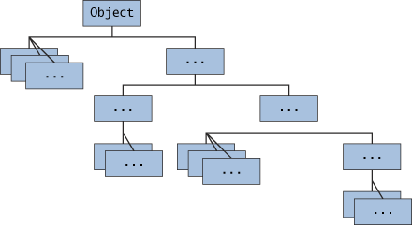
1. OO Programming Concepts Basic Inheritance
Inheritance models is-a relationship
For example: a sedan is a car, a sports car is a car, a circle is a geometric object
Inheritance allows you to define a very general class then later define more specialized classes by adding new detail
The general class is called the base or parent class (superclass)
The specialized classes are derived from the base class. They are called derived or child classes (subclass)
The specialized classes inherit all the properties of the general class
You only have to write the "difference" or "specialization" code for each derived class
A class hierarchy: classes can be derived from derived classes (child classes can be parent classes)

Slide 9
2. Python Vs Java How does Java compare with Python?
Simple | Architecture neutral
Object oriented | Portable
Distributed | High performance(?)
Multithreaded | Robust (as defined by Gosling)
Dynamic | Secure
Java:
Python:
Java programs are “robust” if they are well-tested: reliable behaviour.
Python is not a strongly-typed language, so a method can produce strange results if given an unexpected input. More difficult to test, so less “robust”?
Simpler than Java | Architecture neutral
Object oriented | Portable
Distributed | Adequate performance
Multithreaded | Less robust?
More dynamic than Java | More difficult to secure?

Slide 10
2. Python Vs Java
Python:
the syntax is sparse, and clear.
the underlying model of how objects and variables work is very consistent.
You can write powerful and interesting programs without a lot of work.
Java:
For very large programs Java and C++ are going to give you the best performance.
Maintainability is very important too.

Slide 11
2. Python Vs Java Dynamic vs Static Typing
It is the way that each language handles variables.
Java forces you to define the type of a variable when you first declare it and will not allow you to change the type later in the program.
This is known as static typing.
Python uses dynamic typing, which allows you to change the type of a variable, by replacing an integer with a string.
Pros & Cons
Dynamic typing is easier for the novice programmer to get to grips with
without worrying too much about their types
However,
Static typing reduces the risk of undetected errors plaguing your program
It is easy to misspell a variable name and accidentally create a whole new variable

Slide 12
2. Python Vs Java Braces vs Indentation
Python:
uses indentation to separate code into blocks
Java:
uses curly braces to define the beginning and end of each function and class definition
public class MyProgram {
public static void main(String[] args) {
System.out.println("Hello world!");
}
}
This area is the body of the class.

Slide 13
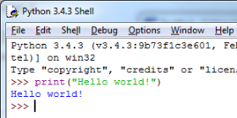


2. Python Vs Java Hello World program
Java doesn’t accept code from the command line!
Note: Python has a command-line interface which will execute a single line of code immediately after you type it
Python Source code: Hello.py
Print the Hello World! message
Java Source code: MyProgram.java
Print the Hello World! message
def main():
print("Hello world!")
main()
Python
Java
Output
public class MyProgram {
public static void main(String[] args) {
System.out.println("Hello world!");
}
}

Slide 14
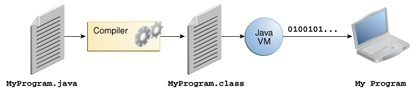

3. Anatomy of Java Java: A Compiled and Interpreted Language
“In the Java programming language, all source code is first written in plain text files ending with the .java extension.
“Those source files are then compiled into .class files by the javac compiler.
“A .class file does not contain code that is native to your processor;
“it instead contains bytecodes — the machine language of the Java Virtual Machine (Java VM).
“The java launcher tool then runs your application [by interpreting its bytecode on] an instance of the Java Virtual Machine.”
Source: http://docs.oracle.com/javase/tutorial/getStarted/intro/definition.html

Slide 15

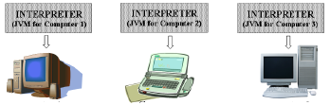
3. Anatomy of Java Java – a mixed system
Java source code (MyProgram.java)
Java byte code (MyProgram.class)
public class MyProgram{
public static void main(String[] args) {
System.out.println("Hello world!");
}
}
javac.exe
java.exe
java.exe
java.exe
Computer 1
Computer 2
Computer 3

Slide 16
3. Anatomy of Java Important Rules
A Java source code file contains one or more Java classes.
If more than one class is in a source code file, only one of them may be public.
The public class and the filename of the source code file must match.
ex: A class named MyProgram must be in a file named MyProgram.java
Every Executable Java program must have a function called: public static void main(String[] args)
This is the method header
for the main method. The
main method is where a Java
application begins.
Class name
Method name
public class MyProgram {
public static void main(String[] args) {
System.out.println("Hello world!");
}
}
This area is the body of the main method.
All of the actions to be completed during
the main method will be between these curly braces.

Slide 17
3. Anatomy of Java Parts of a Java Program
Class Header
The class header tells the compiler things about the class such as what other classes can use it (public) and that it is a Java class (class), and the name of that class (MyProgram).
Curly Braces
When associated with the class header, they define the scope of the class.
When associated with a method, they define the scope of the method.
The main Method
This line must be exactly as shown in the example (except the args variable name can be programmer defined).
This is the line of code that the java command will run first.
This method starts the Java program.
Every Java application must have a main method.

Slide 18

3. Anatomy of Java Structure of a Java program
public static void main(String[] args):
the following lines look similar but are in fact treated by Java as completely different methods
public void main(String[] args)
public static void main(String args)
public static void main()
void main(String args)
public indicates to the Java compiler that this is a method that anyone can call
static tells Java that this is a method that is part of the class, but is not a method for any one instance of the class
void tells the Java compiler that the method main will not return a value
args: It is a parameter list for the main method. It is an array of Strings

Slide 19
3. Anatomy of Java Blocks of code
Yeah!
Whitespace, indentation etc. is for human readability only! It has no meaning for the compiler!
Blocks go inside matching pairs of curly braces { and }. Blocks can be nested.
{ {} {} }
Both examples are valid
Whitespace have no syntactic significance in Java. But they help your program more human-readable.
i.e. we prefer to use the first version!
public class MyProgram {
public static void main(String[] args) {
System.out.println("Hello world!");
}
}
public class MyProgram { public static void main(String[] args) { System.out.println("Hello world!"); } }

Slide 20
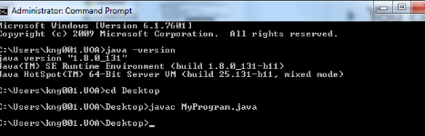

3. Anatomy of Java Compile and Run
You can use any IDE (e.g.: Notepad++, Textpad, Eclipse, etc)
Please check our course website to get information regarding to setting up Notepad++ and textpad for Java programming
You can add commands to compile and run java programs
All Java files have the extension .java.
Start cmd
Go to the current directory:
To compile Java programs we use the javac command,
To run an application we use the java command, e.g.
cd Desktop
javac MyProgram.java
java MyProgram
Note: we only use the class name: “MyProgram”
Never use:
java MyProgram.class
java MyProgram.java

Slide 21
3. Anatomy of Java Errors
Won’t generate class file by the compiler
There are three kinds of errors:
Syntax errors,
These are errors where Java finds something wrong with your program, and you can't execute it.
The compiler will tell you where it got into trouble. Usually the error is on the exact line indicated by the compiler, or on the line just before it;
Runtime errors, and
If there are no syntax errors, Java may detect an error while your program is running
For example: divide by 0 etc
Logic errors.
A logical error, or bug, is when your program compiles and runs, but does the wrong thing.
difficult to find and correct.
Generate unexpected output

Slide 22
3. Anatomy of Java Syntax
Syntax: The set of legal structures and commands that can be used in a particular language.
Every basic Java statement ends with a semicolon ;
The contents of a class or method occur between { and }
Syntax error (compiler error): A problem in the structure of a program that causes the compiler to fail.
Examples:
Missing semicolon
Too many or too few { } braces
Illegal identifier for class name
Class and file names do not match
...

Slide 23
3. Anatomy of Java Syntax error example
1 public class Hello {
2 pooblic static void main(String[] args) {
3 System.owt.println("Hello, world!")_
4 }
5 }
Compiler output:
Hello.java:2: <identifier> expected
pooblic static void main(String[] args) {
^
Hello.java:3: ';' expected
}
^
2 errors
The compiler shows the line number where it found the error.
The error messages can be tough to understand!

Slide 24
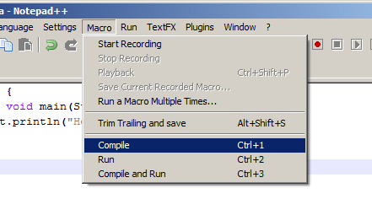
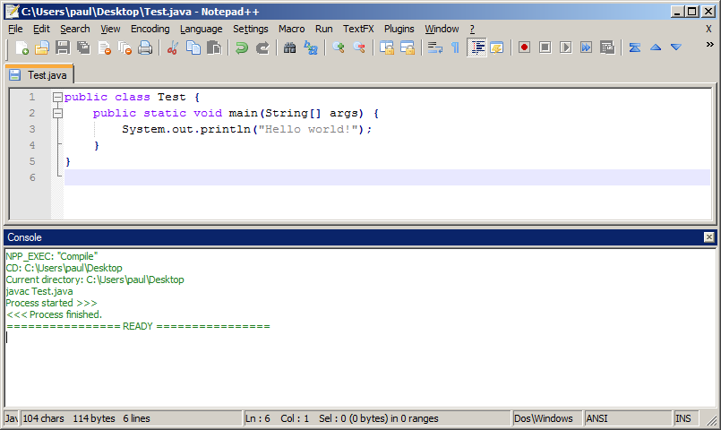
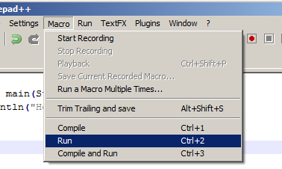
3. Anatomy of Java Example: Using NotePad++
Two steps:
Compile the Java file
Run the program

Slide 25
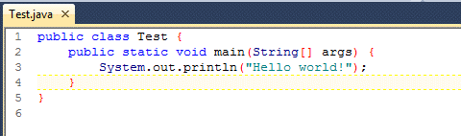
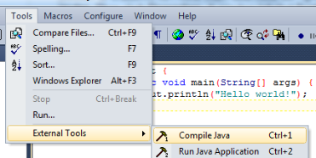
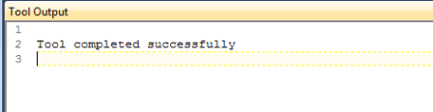
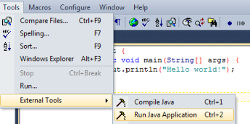
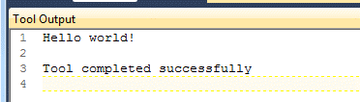
3. Anatomy of Java Example: Using TextPad
Two steps:
Compile the Java file
Run the program

Slide 26
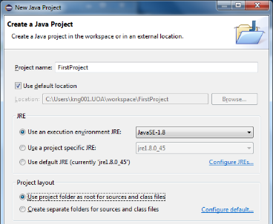
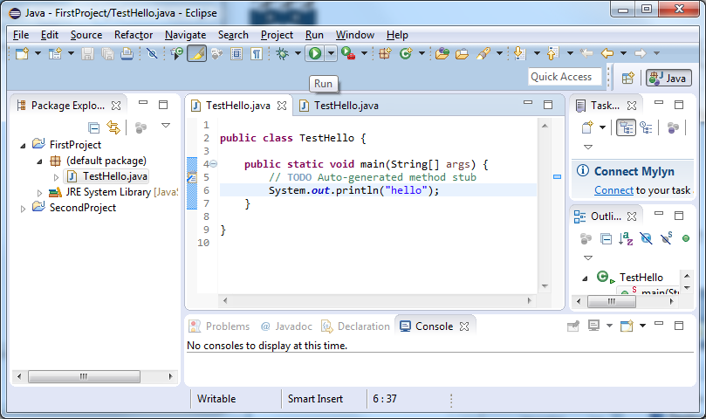
3. Anatomy of Java Example: Using Eclipse
You will need to create a new Java project for each of your Java application
Create a new class/program
Click the “Run” button to compile and run the program

Slide 27
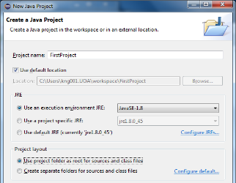
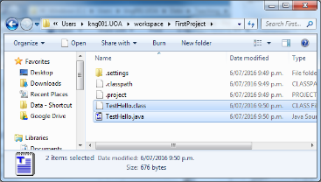
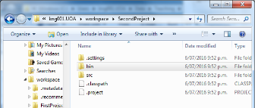
3. Anatomy of Java Example: Using Eclipse con’t
Note: You may want to change the Project Layout setting:
Use project folder as root for sources and class files
All java files and class files are within the root directory
If you choose “Create separate folders…”
The bin folder contains all class files
The src folder contains all java files

Slide 28

Exercise 1
What is missing in the following Java program? Can you compile and run it?
Can you compile and run the following Java program successfully?
public class MyProgram1 {
public static void main(String args) {
System.out.println("Hello world!");
}
}
public class MyProgram2 {
public static void Main(String[] args) {
System.out.println("Hello world!");
}
}

Slide 29


4. Setting up your computer
Installing Java:
http://www.oracle.com/technetwork/java/javase/downloads/index.html
Choose Java SE Downloads -> Java Platform (JDK) 8u131
Click “Accept License Agreement”
Choose Platform and the version number (JDK 8 or jdk1.8.0_131)
There are several equivalent names
Java Standard Edition Development Kit /Java SE Development Kit / JDK
Usually Java is installed in the "Program Files" folder in the C drive of your computer.
Have you installed the JDK correctly?
Type “cmd” in the start menu
Enter “java -version“ in the command prompt window. It should print the version information.

Slide 30
4. Setting Up and Getting Started Common Problems (and Their Solutions)
Compiler Problems:
Common Error Messages on Microsoft Windows Systems
'javac' is not recognized as an internal or external command, operable program or batch file
If you receive this error, Windows cannot find the compiler (javac).

Slide 31
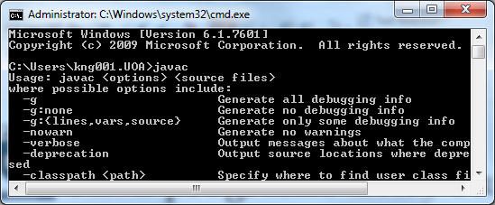
4. Setting Up and Getting Started Solution:
You may have problem in your Path variable on your system.
Check the following
In the start menu, type “cmd”
Type “javac” + press ENTER key
It should display “Usage: javac… “
Otherwise, follow the steps below:
How to fix it:
Go to the C drive, open the Program Files folder, open the Java folder and open the jdk version folder (jdk1.8.x_x) and open the bin folder:
Check that java.exe and javac.exe are in this folder
Now copy the path to the JDK version you are running, e.g.
C:\Program Files\Java\jdk1.8.0_131\bin

Slide 32

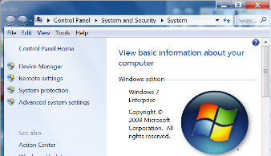
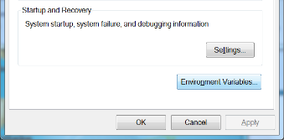
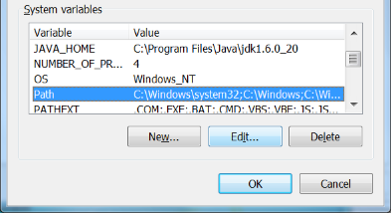
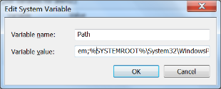
4. Setting Up and Getting Started Solution (con’t)
Type “System” in the start menu and choose System from Control Panel
Click “Advanced system settings” on the left menu
Select the “Advanced” tab and click "Environment Variables“ button
Edit the Path System variable
Insert the path to your JDK after one of the first ";". Your path must be between two ";".
…;SYSTEMROOT%\System32; C:\Program Files\Java\jdk1.8.0_131\bin

Slide 33

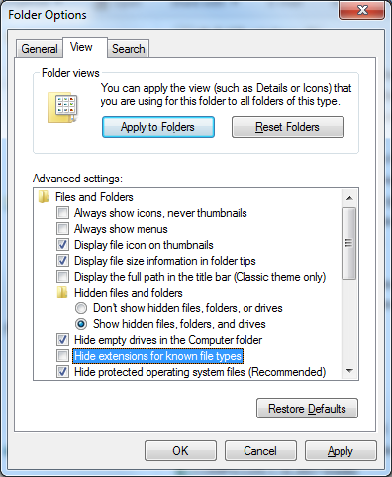
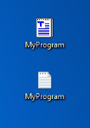
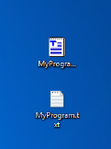

4. Setting Up and Getting Started Common Problem:
Compiler Problems: file not found:
Check your filename carefully.
You may hide the extensions for all known file types by the default setting of your computer.
Go to your current folder, select Organize from the menu, choose Folder and search options
Select the “View” tab, uncheck the “Hide extensions for known file types”
public class MyProgram {
public static void main(String[] args) {
System.out.println("Hello world!");
}
}
javac MyProgram.java
Uncheck the “Hide extensions”

Slide 34
4. Setting Up and Getting Started Common Problem – Running a program
Error message:
Exception in thread "main" java.lang.NoClassDefFoundError: HelloWorldApp/class
If you try to run your program with java HelloWorldApp.class instead of java HelloWorldApp.
Remember, the argument is the name of the class that you want to use, not the filename.
Error message:
Exception in thread "main" java.lang.NoSuchMethodError: main
The Java VM requires that the class you execute with it have a main method at which to begin execution of your application.
main method
public class MyProgram {
public static void main(String[] args) {
System.out.println("Hello world!");
}
}

Slide 35
Things to DO
Download and Install JDK into your own laptop if needed
Read Chapter 1 from D & D
Read The Java Tutorials
Lesson: Object-Oriented Programming Concepts
Compile and Run your first Java program.
public class MyProgram {
public static void main(String[] args) {
System.out.println("Hello world!");
}
}

Slide 36
Exercise 2 Modifying Your First Java Program
1) Displaying a Single Line of Text with Multiple Statements
Display “Welcome to Java Programming” (one line of text) using two statements:
2) Displaying Multiple Lines of Text with a Single Statement
public class MyProgram3 {
public static void main(String[] args) {
//complete this
}
}
Welcome to Java Programming
public class MyProgram4 {
public static void main(String[] args) {
//complete this
}
}
Welcome
to
Java
Programming!

Slide 37
Summary
Java is a case-sensitive language.
All Java programs must be stored in a file with a .java file extension.
A .java file may contain many classes but may only have one public class.
If a .java file has a public class, the class must have the same name as the file.
Java applications must have a main method.
For every left brace, or opening brace, there must be a corresponding right brace, or closing brace.
Statements are terminated with semicolons.
Comments, class headers, method headers, and braces are not considered Java statements.

